Slide 1
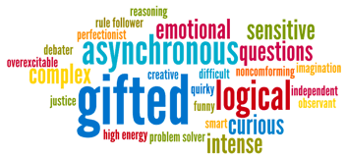

Slide 2
Equity, Individual Differences, Sustainable Development, and Giftedness Education

Slide 3
What is it?
 | Intelligent
 | Gifted
 | Talented
 | Genius
 | Wise
 | Agile
 | Smart
 | Bright
 | Brilliant
 | Intellect
Words associated with Giftedness
IQ
Creativity
Giftedness
Literacy shows that giftedness mostly measures by IQ.
How ever, Later on creativity was added to the definition.
Let’s consider these two elements as what “gifted” conveys.

Slide 4
Rethinking of Giftedness
Giftedness associated with high intelligence and knowledge. Is this enough to be productive?
In following slides it is explained:
Being Gifted is not good predictor for success.
Children labeled as Gifted have more emotional problems
Gifted children have many challenges for their label
Gifted children have not contribution in society as they are expected.
Investing on gifted children/education has side effects.
It seems to need to redefine giftedness because above definition does not match with expectations from those labeled as gifted.

Slide 5
Is Giftedness Good Predictor for Success?
J, Freeman, 2006: Giftedness in the Long Term
He indicates in his 50 years longitude study that:
Gifted children are not always outstanding successful in their adult.
Better predictors are hard-work, emotional support, and a positive, open personal outlook.
He also found that the labeled gifted children have more emotional problems.

Slide 6
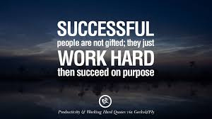
Giftedness or hardworking?
Studies Indicate:
It Is about hard work: The greatest predictor of success is how many hours are devoted to any goal. It is the hard work behind their natural abilities that will guarantee their life-long success.
Little life message:
Teach your children that if they work hard enough they can achieve all their dreams.
DO NOT RELY ON YOUR NATURAL GIFTEDNNESS

Slide 7
What are gifted challenge?
Introvert: They are most likely shows shy, strict in get friends, …
Labeling as gifted may press her for good result despite her interest, ability, and choice.
Being labeled as gifted in an area may limit her to choose fun things
Labeled kids have more emotional problems compare to unlabeled as gifted ( freeman, J. 2004)
Entitlement: They believe they deserve more than others
They expect success without effort
Soon they are the same as everyone else
unearned status: The people may not appreciate them due to the fact that they did not earn what they have.

Slide 8
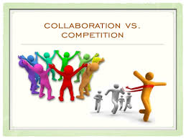
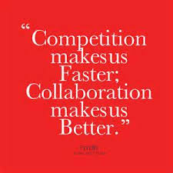
Gifted-Oriented Education System Fails
Gifted-Oriented system promote Competition instead of Collaboration
While gifted receive more attention, advantages, rewards, and so on; why not all children try to be one of them?
World is pursuing: Critical Thinking, Communication, Collaboration, and Creativity.
And competition has no role in this perspective.

Slide 9
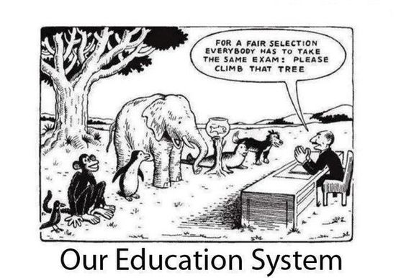
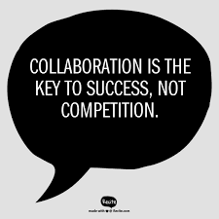
Why “NO” to Competition?
Competition is the source of anxiety.
Competition is the source of feeling unable, loosing self-esteem and self-confidence.
Concentrate to be the winner prevent learning in depth.

Slide 10
Harms caused by Gifted-Oriented Education
- Increasing disappointment within most and majority of students
The students who not recognized as gifted would not accept the responsibility of their own because it is not their fault that the nature did not choose them to be GIFTED.
Give the message to others that they are not able to achieve their dreams.

Slide 11
Gifted-Oriented Education and Individual Differences
Embracing individual differences not match with gifted-oriented education
Highlighting giftedness means one of multiple intelligences(MI) is main and the rest are mean (not important).

Slide 12
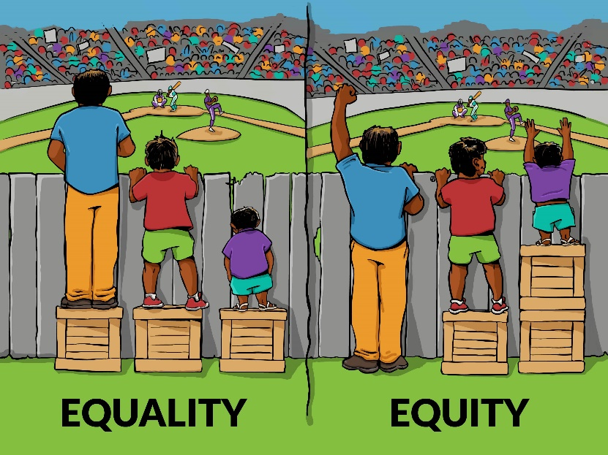
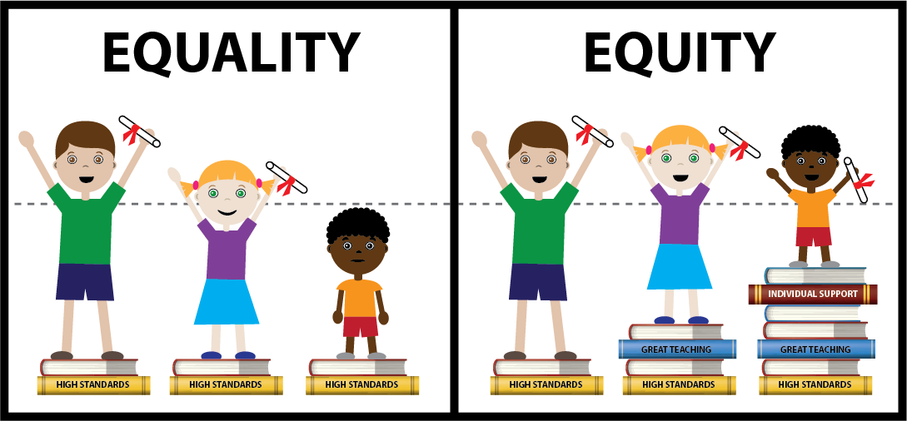
Gifted-Oriented system vs. Equity
Gifted-oriented education prevent achieving general goals of education which is to provide competencies for life in 21st Century.
Education system is supposed to serve all civics
The ultimate purpose of education system is happiness, independence, self-control, able to run own life, and life-long learner members for society

Slide 13
What Gifted will Return to the Society?
It is been spread that stars and genius people should be the leaders and rulers.
Does this statement refers to gifted? It seems that if the above statement is true, it is not referring to gifted rather some thing more than a talent.
Moreover, let’s assume that above statement refer to gifted people. Then the question is how much the people with most influence in every culture, country and the world has been recognized as gifted and receive special education?
Beside, if gifted people made difference in their country, organization, and society in old centuries ; it does not seem to be like this anymore.
Contemporary society is been built and developed on collaboration and team working not on stars.

Slide 14
In Sum
individually aspect giftedness as it is defined and recognized generally in educational system, schools, by parent, and by folks is not indicating success. Beside, they have emotionally more problems, and this labell make many pressure for them.
Socially aspect and concerning to society, gifted people who are known as stars are not effective as it is expected. Researches indicates that groups with one or two stars achieve meaningfully less than groups with average abilities who have desire for dialogue, engagement, and cooperate.

Slide 15
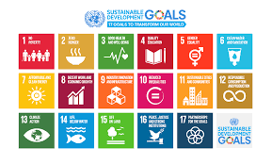
SUSTAIABLE DEVELOPMENT
UN announced 17 goals for sustainable development. The forth goal is:
SUSTAINABLE DEVELOPMENT GOAL 4
Ensure inclusive and equitable quality education and promote lifelong learning opportunities for all
Gifted education in essence is a breach in quality education for all. The system that headed to segmented gifted and expect them to grow the society, automatically decrease the notice to the rest of students.

Slide 16
New Definition for Higher Abilities
Latest finding about people with higher abilities (new definition for giftedness) emphasizes and added new components to giftedness or talented.
Sternberg (2007) indicate that “wisdom” is the concept that should be the concern of education.

Slide 17
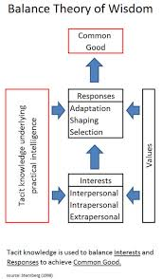
What is wisdom?
wisdom involves forming a judgment when there are competing interests that lack a clear resolution ( Sternberg, 2007)
wisdom is the use of one’s intelligence, creativity, common sense, and knowledge and as mediated by positive ethical values toward the achievement of a common good through a balance among (a) intrapersonal, (b) interpersonal, and (c) extra-personal interests, over the (a) short and (b) long terms to achieve a balance among (a) adaptation to existing environments, (b) shaping of existing environments, and (c) selection of new environments.

